Slide 1
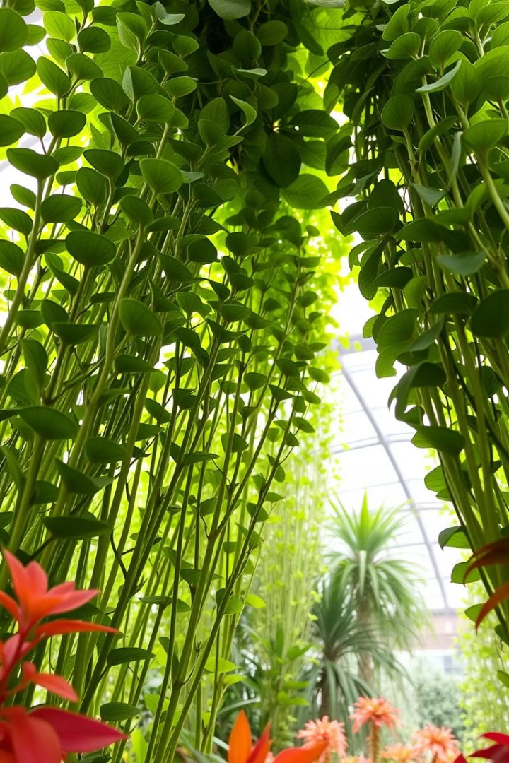
al-Farabi Ka akh National University
Faculty of Biology and biotechnology
Department of Biodiversity and Bioresources
The Structure of the Shoot System
The shoot system is a vital part of plant anatomy. It includes stems, leaves, and buds. Understanding its structure is crucial for botany. It is important for understanding plant function and adaptation.

Slide 2
Introduction: The Shoot System
Definition
Importance
Overview
The shoot system is the above-ground part of a plant. It includes stems, leaves, and reproductive structures.
It performs essential functions such as photosynthesis, transport, and reproduction. Shoots enable plants to thrive.
Understanding the shoot system is vital for comprehending plant biology and ecological interactions.

Slide 3
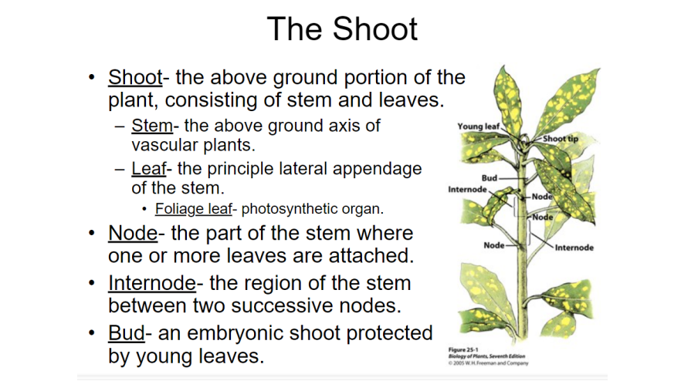

Slide 4
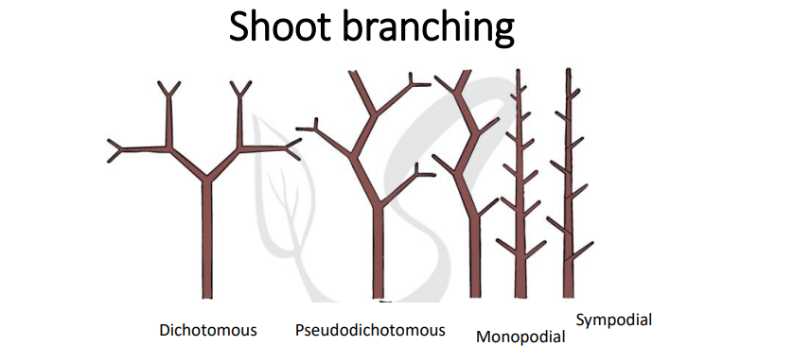

Slide 5

Branching Patterns
Dichotomous
1
The stem divides into two equal branches. This pattern is rare in flowering plants.
2
Monopodial
The main stem grows continuously. Lateral branches develop from it.
Sympodial
3
The main stem stops growing. Lateral branches take over as the primary shoot.

Slide 6
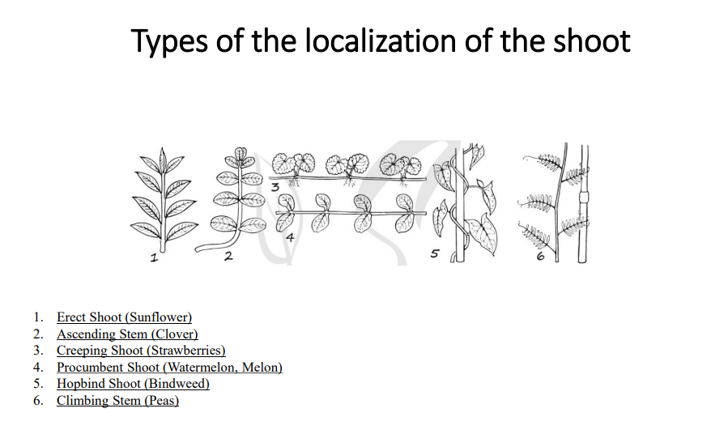

Slide 7
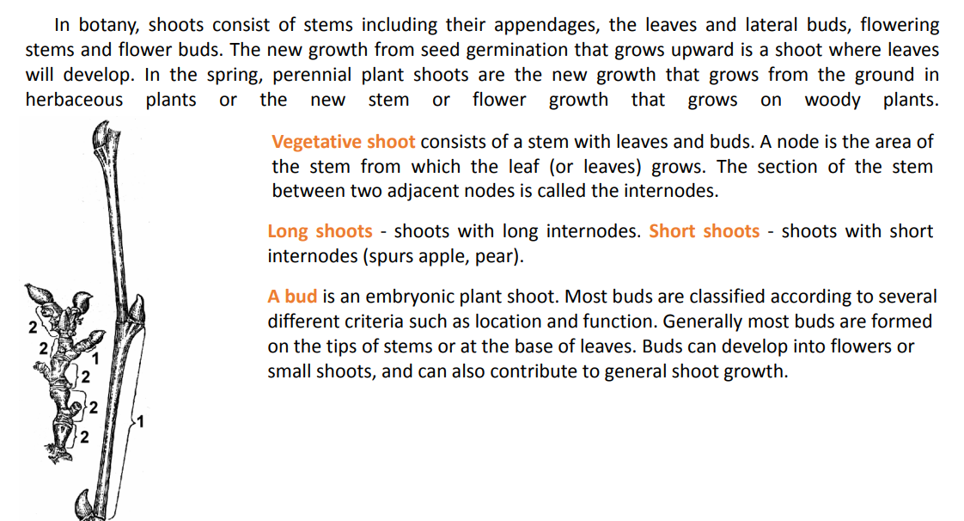

Slide 8
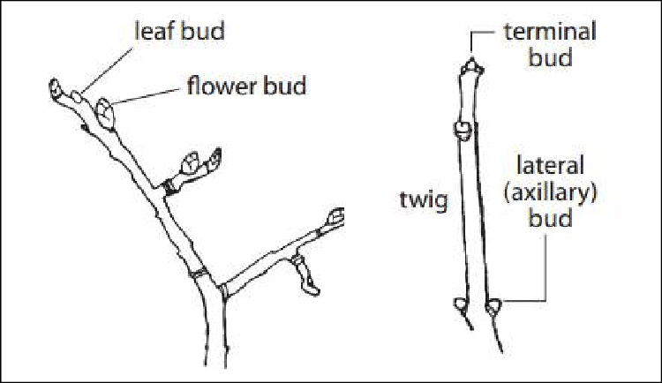

Slide 9
Botanists commonly use the following terms:
for location:
  terminal, when located at the tip of a stem (apical is equivalent but rather reserved for the one at the top of the plant);
  axillary, when located in the axil of a leaf (lateral is the equivalent but some adventitious buds may be lateral too);
  adventitious, when located elsewhere, for example on the trunk or roots (some adventitious buds may be former axillary ones that are reduced and hidden under the bark, while other adventitious buds are completely new formed ones).
for status:
  accessory, for secondary buds formed besides a principal bud (axillary or terminal);
  resting, for a bud that forms at the end of a growth season, and then lies dormant until the onset of the next growth season;
  dormant or latent, for buds whose growth has been delayed for a rather long time. The term is usable as a synonym of resting, but is better employed for buds waiting undeveloped for years, for example epicormic buds;
  pseudoterminal, for an axillary bud taking over the function of a terminal bud (characteristic of species whose growth is sympodial: terminal bud dies and is replaced by the closer axillary bud, for examples beech, persimmon, Platanus have sympodial growth).

Slide 10
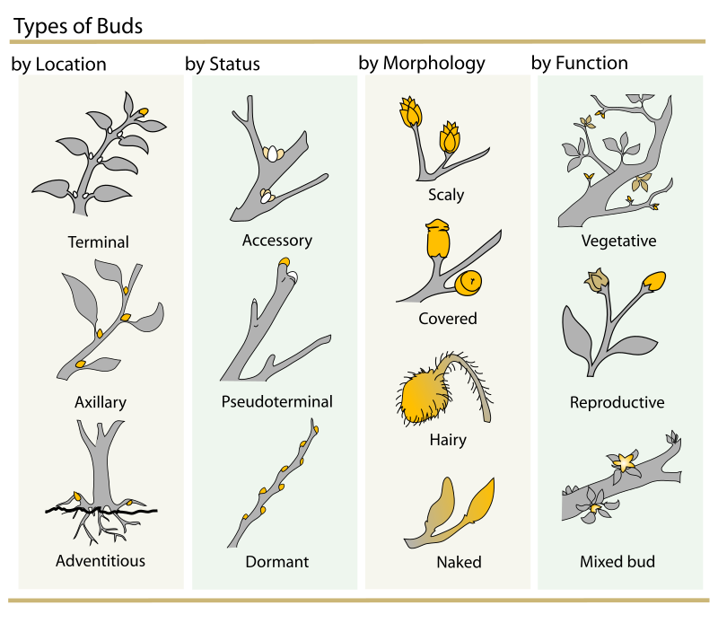

Slide 11
for morphology:
  scaly or covered (perulate), when scales, also referred to as a perule (lat. perula, perulaei) (which are in fact transformed and reduced leaves) cover and protect the embryonic parts;
  naked, when not covered by scales;
  hairy, when also protected by hairs (it may apply either to scaly or to naked buds).
for function:
  vegetative, only containing vegetative structures: a leaf bud is an embryonic shoot containing leaves;
  reproductive, only containing embryonic flower(s): a flower bud contains a single flower while an inflorescence bud contains an inflorescence;
  mixed, containing both embryonic leaves and flower(s).

Slide 12
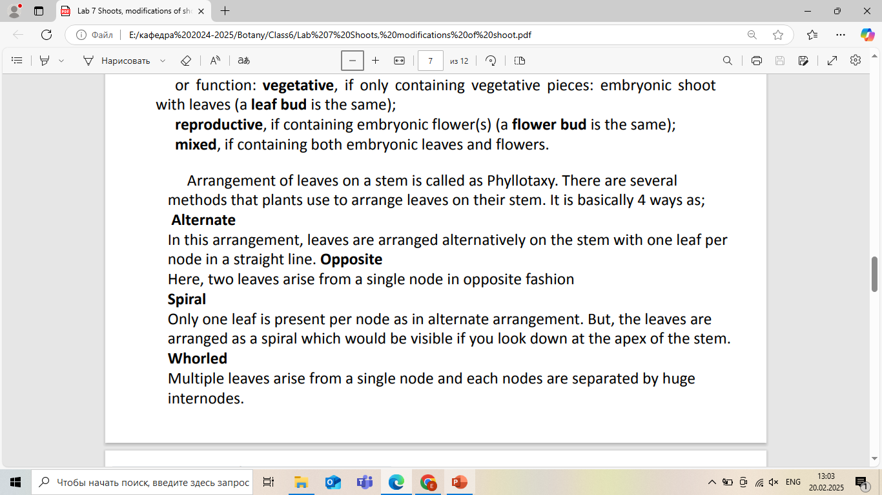

Slide 13
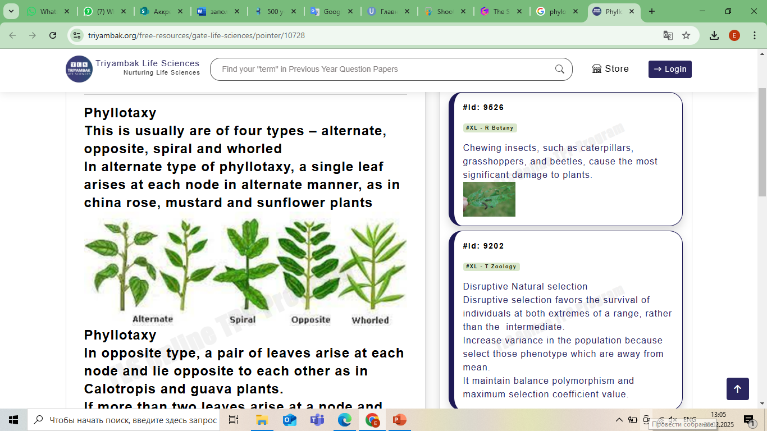

Slide 14
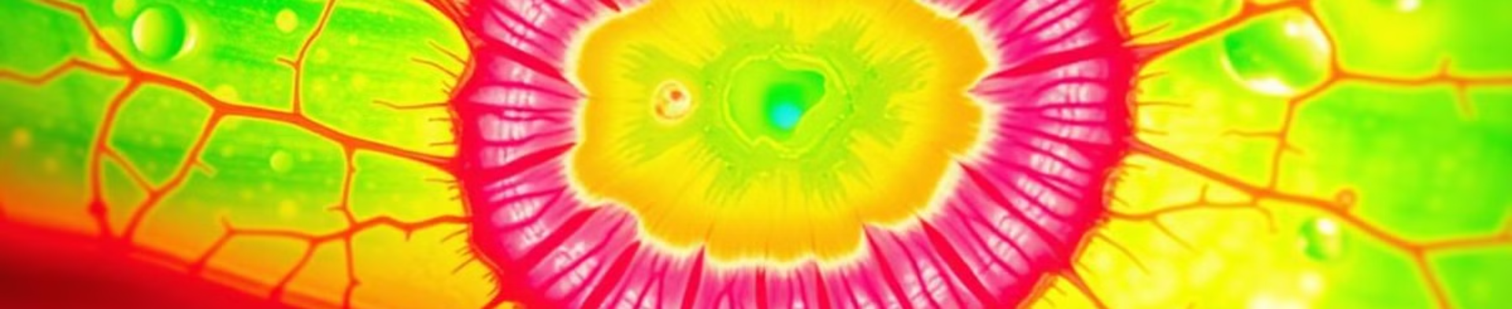
The Stem: Anatomy and Functions
Support
Transport
Storage
Stems provide structural support to the plant. They hold leaves and reproductive organs upright.
Vascular tissues in stems transport water and nutrients. Xylem and phloem are essential for plant survival.
Some stems store food reserves. These reserves help plants survive adverse conditions.

Slide 15
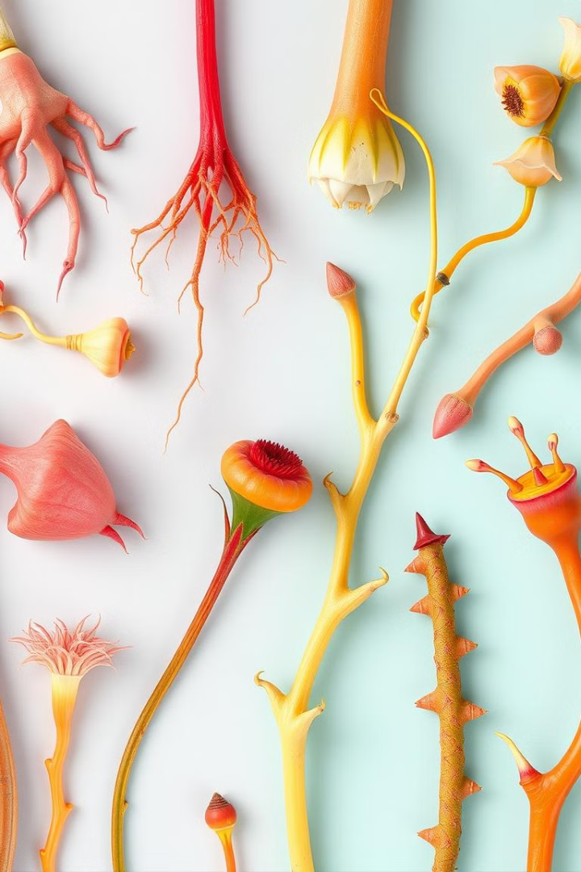



Stem Modifications
Rhizomes
Tubers
Tendrils
Horizontal underground stems. Rhizomes store nutrients and enable vegetative propagation.
Swollen underground stems. Tubers like potatoes store starch for energy.
Modified stems that aid in climbing. Tendrils provide support for vining plants.

Slide 16




Leaves: Morphology and Adaptations
Morphology
Leaves vary in shape, size, and arrangement. These characteristics depend on the species and environment.
Venation
Venation patterns include parallel and reticulate types. These patterns facilitate nutrient transport.
Adaptations
Leaves adapt to different light and moisture conditions. Adaptations enhance survival.

Slide 17
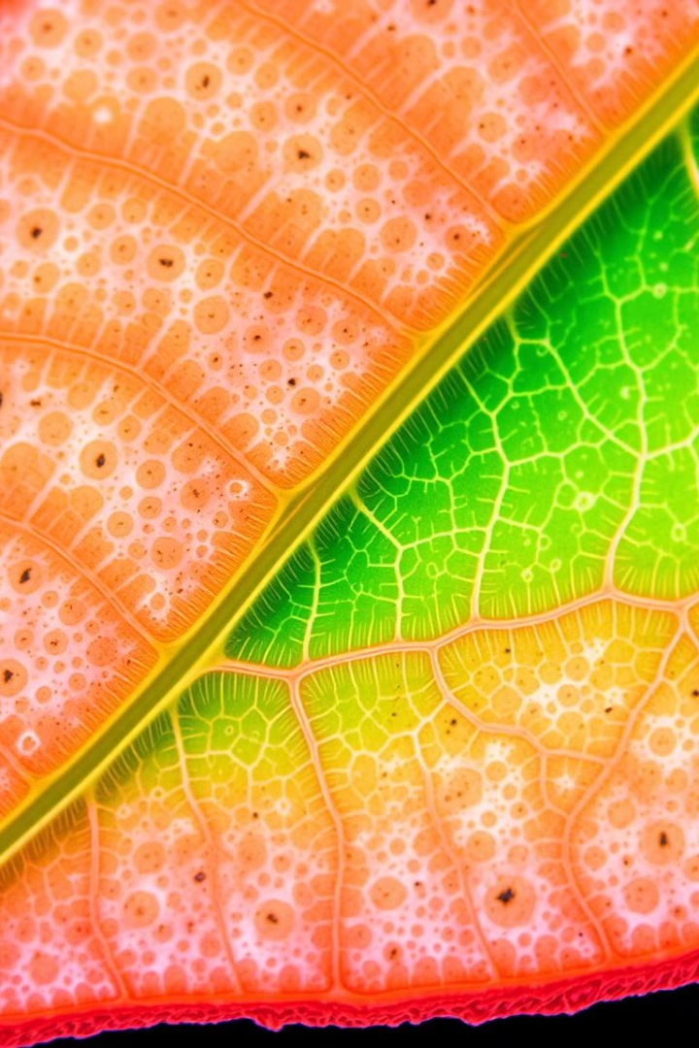
Leaf Anatomy: Microscopic View
1
Epidermis
2
Mesophyll
The outer layer protects the leaf. It reduces water loss.
Mesophyll contains photosynthetic cells. It is where most photosynthesis occurs.
3
Vascular Bundles
Xylem and phloem transport water and nutrients. They are vital for leaf function.

Slide 18



Bud Structure and Development
Axillary Buds
2
Located in the leaf axils. They give rise to lateral branches or flowers.
Apical Buds
1
Located at the tip of the stem. They promote primary growth.
Development
Buds develop into new shoots or flowers. Hormones regulate bud development.
3

Slide 19
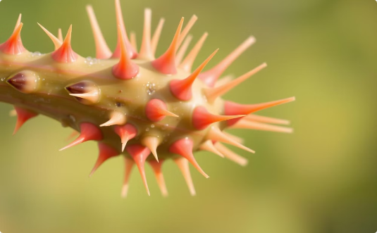
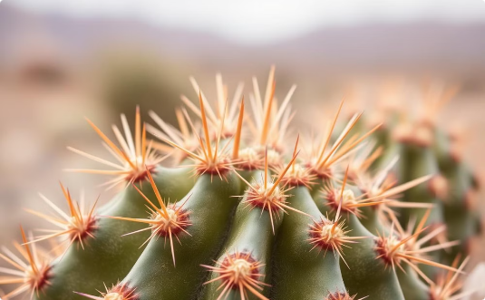
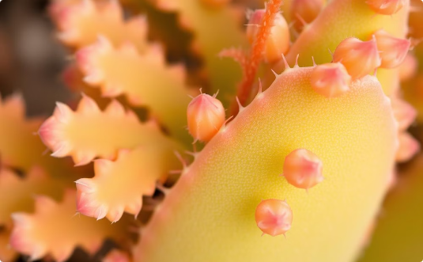
Specialised Shoots
Thorns
Spines
Cladodes
Modified branches providing protection from herbivores.
Modified leaves that reduce water loss and offer defence.
Flattened stems that perform photosynthesis in place of leaves.

Slide 20
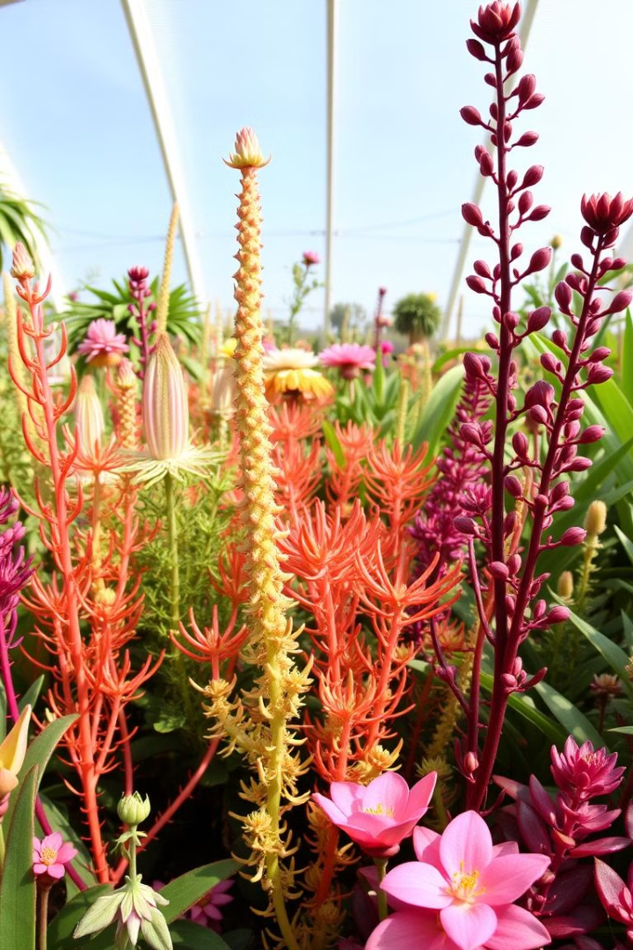
Conclusion: Shoot Structure
4
3
Parts
Functions
The shoot system comprises stems, leaves, and buds.
Support, transport, and photosynthesis are vital functions.
∞
Adaptation
Shoots show varied adaptations to diverse environments.
Understanding the structure of the shoot system enhances our appreciation of plant biology. It highlights its ecological significance.

